Slide 1

ChefConnect
Professional Cooking At Home
By: Stephan Pierre, Jeremias Batista, Munif Wahid, Isaac Amos, Karim Khalil, Nelson Acero

Slide 2

Member Roles
BACKEND
Stephan
Munif
Nelson
FRONTEND
Karim
Jeremias
Isaac
2

Slide 3


What
An app that allows users to purchase local chef service that come in and cook for specific time frames. Users can input cultural meals they want and chefs come in and cook them OR the user can input the ingredients they have and chef make a special cuisine they'd like. (Cuisine Chef & Pantry Chef)
Why
For convenience.
To treat yourself or others.
As a chef, get the chance to get yourself out there.
3

Slide 4
Customer’s Journey
Login / Sign up
Fill in Pantry Profile
Browse Chefs
Select Date & Time
Book Chef
Leave Review
Chef Cooks Meal
Edit/ Confirm Pantry
4

Slide 5
Chef’s Journey
Login / Sign up
Create Chef Profile
Receive Booking
View Pantry
Receive Payment & rating
Cook Meal
Plan Meal
5

Slide 7
Data Model
We offer flexible, scalable services for businesses of all sizes.
Monthly Retainer
Packages
One-Off Campaigns & Consulting
Workshops & Training for In-House Teams
Tiered pricing (Starter / Growth / Premium)
Includes a set number of services: strategy sessions, content creation, campaign management, etc.
Ideal for businesses needing consistent support and measurable results over time
Predictable revenue and long-term client relationships
Project-based pricing for seasonal or special campaigns
Includes short-term social media pushes, product launches, rebranding, or digital audits
Ideal for clients testing the waters or addressing a specific need
Interactive, skill-based training: SEO, social media strategy, content planning, reporting
Delivered via webinars, video modules, or on-site sessions
Great for businesses building internal marketing capability
Revenue stream that also builds brand authority
6

Slide 8
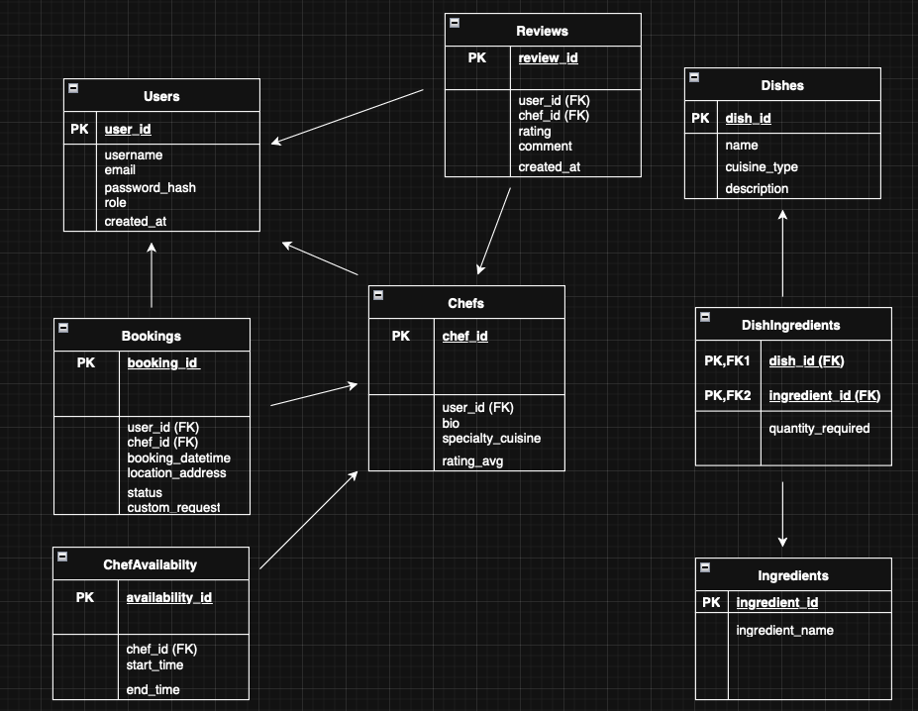
Relational Schema
6

Slide 9
The Stack
Frontend
Backend
Database
Repository
React
Builds a dynamic interface for browsing chefs, managing bookings, and viewing schedules.
Python with FastAPI
Handles authentication, booking logic, APIs, payment state, and review flow.
MySQL
Stores structured relational data for users, providers, services, bookings, payments, and reviews.
GitHub
Used for version control, team collaboration, code sharing, and project management.
2-send booking to
3-booking save in
1-User book
React
FastAPI
MySQL
6-show confirmation
5-send success
4- confirm saves
7

Slide 10
Revenue
Revenue Stream | How it works
Platform Commission | 15% Cut of Every booking
Booking Fee/Service Fee | $3 flat fee per customer transaction
Chef Premium Membership | $9.99 for featured placement
Data & Ad Partnerships | Sell anonymized ingredient/preference data to food brands
8

Slide 11
Q & A
QUESTIONS?
9

Slide 12
The End
THANK YOU FOR LISTENING

